Slide 1
Maha Kumbh Mela 2025: Staggering Logistics Captured from Space
How to read satellite image (map legend)
Vegetation
Urban area
River water
Temp bridges
Tent city
Sentinel 2 image on the left is captured on 19 September 2024. Ganges river flowing from top down covered the entire flood plain, following the rainy season. Yamuna river is flowing from left to right. Note the difference in water colours at the confluence of two rivers. Obviously no visible sign of mela related construction activity by this date.
Sentinel 2 image on the left is captured on 19 October 2024. Ganges river flood plain receded considerably by this time. Flood plain is still wet but reveals underlying road network.
Sentinel 2 image on the left is captured on 3 November 2024. Flood plain is covered by vegetation by this time. We can see bit more of road network within the flood plain.
Credits: European Union. Contains modified Copernicus Sentinel 2 Data 2025
Data analysis @ Shanti Reddy

Slide 2
Maha Kumbh Mela 2025: Staggering Logistics Captured from Space
How to read satellite image (map legend)
Vegetation
Urban area
River water
A
Temp bridges
Tent city
B
Sentinel 2 image on the left is captured on 28 November 2024. Note the difference in water colour at the confluence of two rivers. Construction of temp bridges (at A) and temp accommodation (at B) can be seen clearly.
Sentinel 2 image on the left is captured on 8 December 2024. Tents start to appear in this image.
We can also see construction of temporary bridges in advance stage by now.
Sentinel 2 image on the left is captured on 23 December 2024. Temporary bridges and most of the tents are in place by now. Note the lighter tone on the river bank, which indicates not many pilgrims onsite at this stage.
A
Credits: European Union. Contains modified Copernicus Sentinel 2 Data 2025
Data analysis @ Shanti Reddy

Slide 3
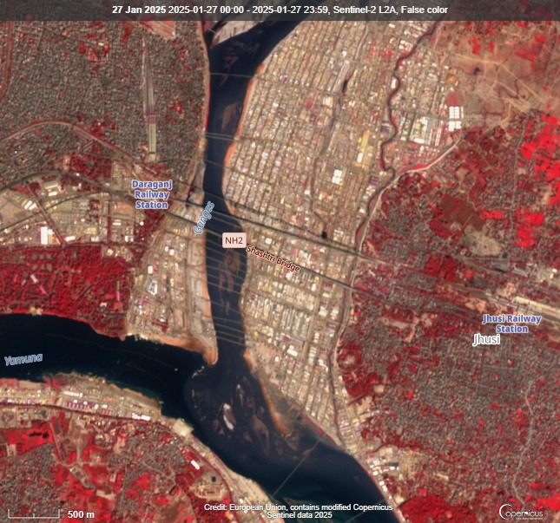
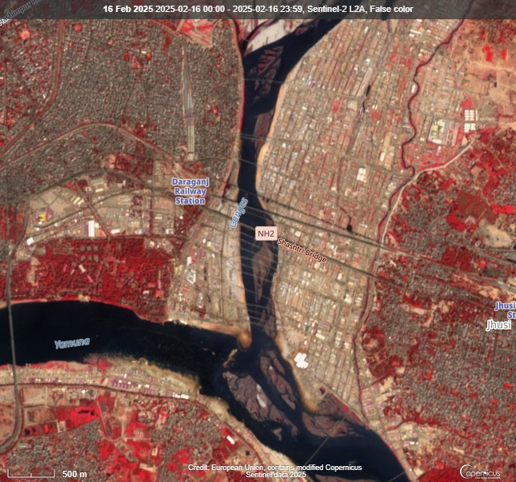
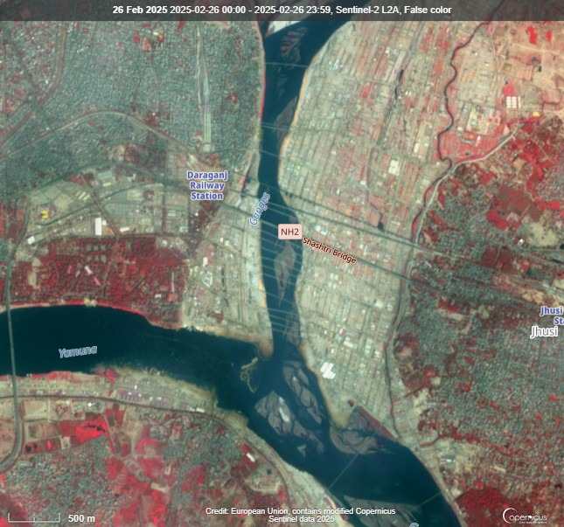
Maha Kumbh Mela 2025: Staggering Logistics Captured from Space
How to read satellite image (map legend)
Vegetation
Urban area
River water
Temp bridges
Tent city
A
Sentinel 2 image captured on 27 January 2025. Notice the dense gathering of people seen as dark brown colour near the area marked “A”
Sentinel 2 image on 16 Feb 2025. Riverbank area where pilgrims take a dip still looks very busy and packed.
A
Sentinel 2 image captured on the last day of Maha Kumbh Mela 26 Feb 2025 still looks busy but appears less dense based on the image tone.
Credits: European Union. Contains modified Copernicus Sentinel 2 Data 2025
Data analysis @ Shanti Reddy

